Slide 1
Review of Combinational Circuit Design
M. Balakrishnan
Dept. of Comp. Sci. & Engg.
I.I.T. Delhi

Slide 2
Combinational Circuit: Definition
Inputs
Outputs
f
O = f ( I )
Present output(s) is a function of present
inputs only.

Slide 3
Boolean Functions
AND, OR, NOT, NAND, NOR, EXOR etc.
Unique truth table
Total of 2⁴ 2-input functions
Universal gate set {NAND}, {NOR} etc.

Slide 4
Canonical Representation
Sum of minterms
Product of maxterms

Slide 5
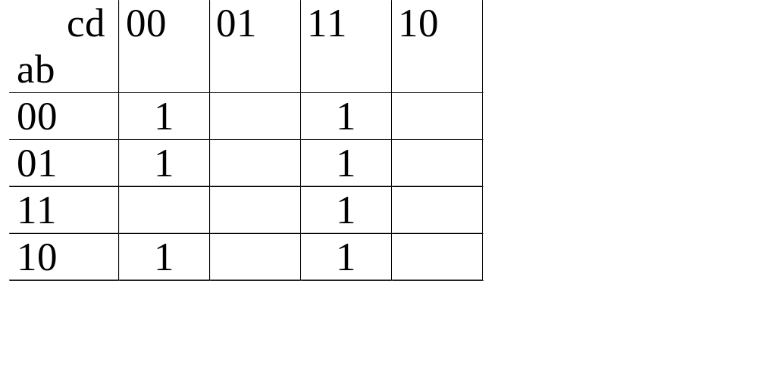
Karnaugh Map
y = f(a,b,c,d) = Σ (0,3,4,7,8,11,15)

Slide 6
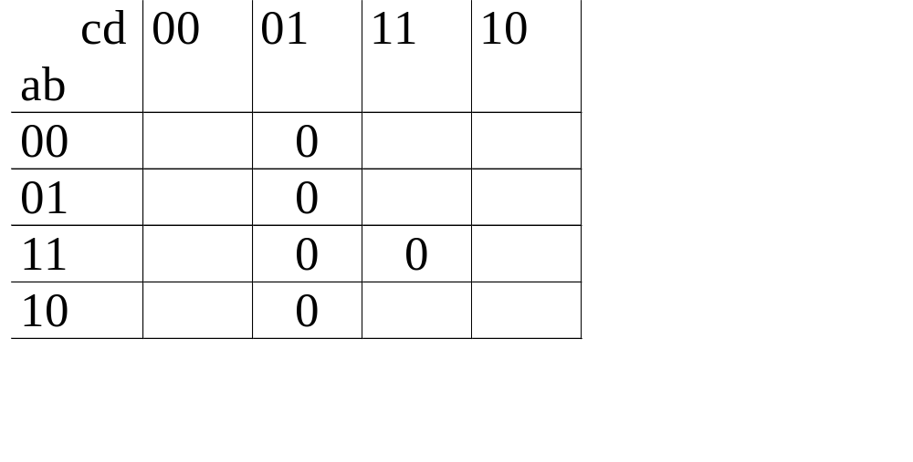
Karnaugh Map (contd.)
y = f(a,b,c,d) = Π (1,5,9,13,15)

Slide 7
Duality
Replace the following and any equality will hold
  AND by OR and vice-versa
  0 by 1 and vice-versa
Demorgon’s laws
  (a + b)’ = a’.b’
  (a.b)’ = a’ + b’

Slide 8
Minimization Objectives
Number of literals for cost/area
Number of levels for time

Slide 9
Symmetric Functions
Exchange variables and the function does not change
  e.g. parity function

Slide 10
Combinational Circuit Design using MSI Blocks
M. Balakrishnan
Dept. of Comp. Sci. & Engg.
I.I.T. Delhi

Slide 11
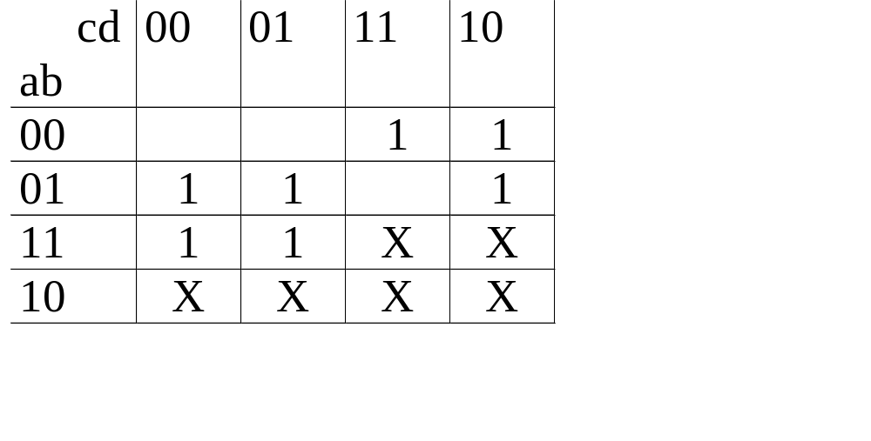
Incompletely Specified Functions
y = f(a,b,c,d) = Σ m(2,3,4,5,6,8,9) + Σ d(10,11,12,13,14,15)

Slide 12
Why Incompletely Specified Functions ?
Outputs actually do not matter for certain subset of inputs
A subset of inputs do not (or cannot) occur

Slide 13
Combinational MSI Blocks
Blocks for implementing logic
Decoders
Encoders
Multiplexers
ROMs
PLAs

Slide 14
Combinational MSI Blocks (contd.)
Arithmetic MSI Blocks
Adders
Subtractors
ALUs
Comparators

Slide 15
Decoder
n to 2^{n} decoder

Slide 16
Logic Implementation Using Decoders
y = f(a,b,c) = Σ m(0,3,4,6,7)

Slide 17
Multiplexer
2^{n}:1 Multiplexer (n select lines)

Slide 18
Logic Implementation Using Multiplexers
y = f(a,b,c) = Σ m(0,1,3,5,6)

Slide 19
Logic Implementation Using Multiplexers (contd.)
y = f(a,b,c) = Σ m(0,1,3,5,6)
0 1 2 3
a’ 1 1 0 1
a 0 1 1 0

Slide 20
ROM (Read Only Memory)
2^{n} × m ROM (n address and m outputs)

Slide 21
Implementing Logic Using ROMs
Direct implementation of the function
Extremely flexible as reprogramming can implement a completely different function

Slide 22
PLA (Programmable Logic Arrays)
PLASpecification: n × k × m
(N inputs, K product terms and M outputs)
^{AND}
^{Plane}
^{OR}
^{Plane}

Slide 23
Implementing Logic Using PLAs
Direct implementation of SoPs
Implement product terms in the AND plane
Implement sum in the OR plane

Slide 24
Implementing Logic Using PLAs (Example)
y1= ab + b’c’d’ y2 = ab + bc’ + c’d’
ª
^{b}
^{c}
^{d}
^{y1}
^{y2}

Slide 25
Summary
To implement a n-variable function (with k minterms)
n to 2^{n} decoder + k input OR gate
2^{n}:1 multiplexer
2^{(n-1):}1 multiplexer + 1 inverter
2^{n}×1 ROM
n× p× 1 PLA with p ≤ k

Slide 26
Combinational Circuits using Multiple Modules
M. Balakrishnan
Dept. of Comp. Sci. & Engg.
I.I.T. Delhi

Slide 27
3 to 8 Decoder

Slide 28
4 to 16 Decoder

Slide 29
Coincident Decoding

Slide 30
4:1 Multiplexer

Slide 31
Tri-State Buffer
Input = { 0 , 1}
Output = { 0, 1, Z }

Slide 32
4:1 Mux Using Tri-state Outputs

Slide 33
64×1 ROM

Slide 34
ROM Pin Connections
2^{n}×m
ROM

Slide 35
Iterative Circuits
M. Balakrishnan
Dept. of Comp. Sci. & Engg.
I.I.T. Delhi

Slide 36
Adder
a_{i}
b_{i}
1 - bit
Full
Adder
c_{i-1}
c_{i}
s_{i} = a_{i} + b_{i} + c_{i-1}
c_{i} = a_{i}.b_{i} + c_{i-1}(a_{i} + b_{i})
s_{i}

Slide 37
Comparator
a_{i}
b_{i}
g_{i-1}
g_{i}
1-bit
comparator
e_{i-1}
e_{i}
l_{i-1}
l_{i}
e_{i} = e _{i-1}.(a_{i}’b_{i}’ + a_{i}.b_{i})
g_{i} = a_{i}.b_{i}’ + g _{i-1}.(a_{i}’b_{i}’ + a_{i}.b_{i})
l_{i} = a_{i}.b_{i}’ + l _{i-1}.(a_{i}’b_{i}’ + a_{i}.b_{i})

Slide 38
Even-Odd Detection
a_{i}
1 - bit
Cell
c_{i-1}
c_{i}
Detecting Number of 1’s in a pattern is even/odd
c_{i} = 1 if number of 1’s among a₀ to a_{i} is odd
0 otherwise

Slide 39
Iterative Pattern Recognition
P = ‘1101’
X = Input
Y = Output
y_{i} = 1 if <x_{i}, x_{i-1}, x_{i-2}, x_{i-3}> = ‘1101’
0 otherwise

Slide 40
Pattern Recognition: Example
c_{i} = 00 if no match till now
01 if 1-bit match till now
10 if 2-bit match till now
11 if 3-bit match till now

Slide 41
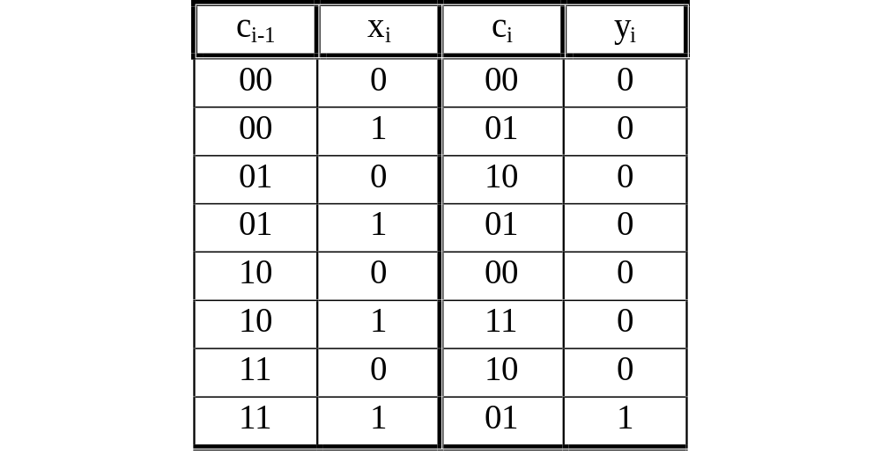
Pattern Recognition: Example

Slide 42
Pattern Recognition: Example
x_{i}
c¹_{i-1}
c¹_{i} = Σm (1,3,5,7)
c¹_{i}
c²_{i} = Σm (2,5,6)
c²_{i}
c²_{i-1}
y_{i} = Σm (7)
y_{i}

Slide 43
Simplification of Boundary Cells
In each case boundary cells can be simplified
Adder circuit: LSB can be half adder
Comparator: Only equal input for LSB
Pattern recognizer: LSB 3-bits can be simplified

Slide 44
Speeding Up Iterative Structures
Iterative structures are regular but slow as delay adds up.
Techniques used to speed up are
Multi-bit inputs per cell
Carry lookahead generators

Slide 45
Multi-bit Iterative Circuits
x_{i}
x_{i+1}
2 - bit iterative
cell
c¹_{i-1}
C¹_{i+1}
C²_{i+1}
c²_{i-1}
y_{i}
y_{i+1}

Slide 46
Carry Lookahead Generation
Generate g_{i} = a_{i}.b_{i}
Propagate p_{i} = a_{i}+b_{i}

Slide 47
Logic Minimization: Tabular Methods
M. Balakrishnan
Dept. of Comp. Sci. & Engg.
I.I.T. Delhi

Slide 48
QM vs. K-Map
K-Map is a graphical method and thus not suitable for large no. of variables
K-Map method is also not suitable for programming
QM (Quine-Mcluskey) method does not suffer from these disadvantages

Slide 49
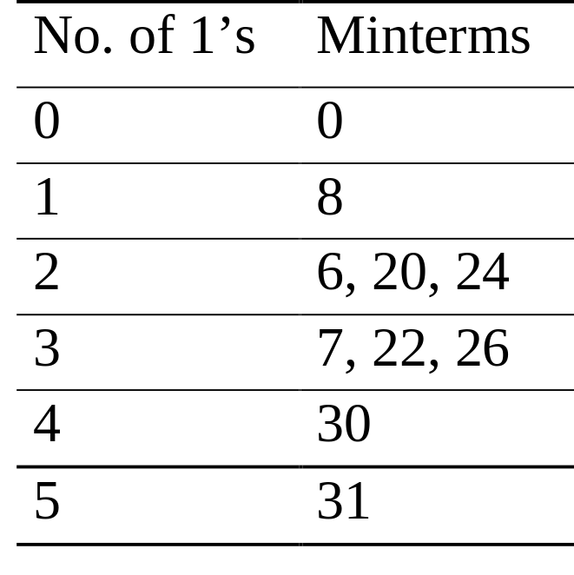
QM Method: Example
y = f(a,b,c,d,e) = Σm(0,6,7,8,20,22,24,26,30,31)
Classify by number of 1’s in the binary rep.

Slide 50
Combining Minterms: Conditions
Two minterms can be combined to form a implicant (I) if and only if:
The integer values of the two minterms differ by 2^{k} for some k ≥ 1
The minterm with a larger integer value has more 1’s than the minterm with a smaller integer value

Slide 51
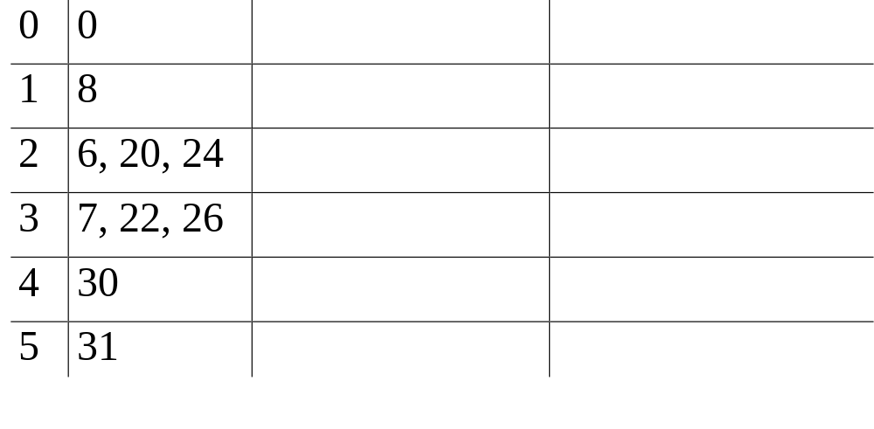
Generation of Implicants

Slide 52
Prime Implicants
A prime implicant is which is not fully contained in any other implicant i.e. there is no other implicant which contains all the minterms contained in this implicant.

Slide 53
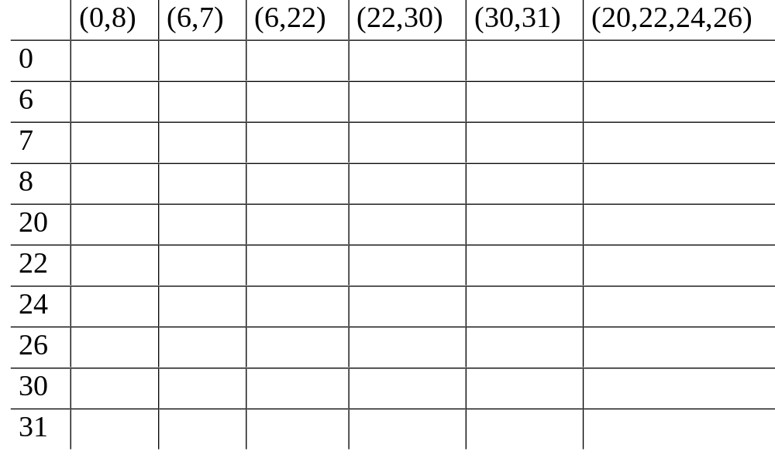
Cover Table

Slide 54
Essential Prime Implicants
Essential prime implicants are those which cover minterm(s) not covered by any other prime implicant.
Any minimal function have to include the essential prime implicants

Slide 55
QM Method: Steps
Order minterms by no. of 1’s (integer value)
Generate implicants by repeated combination of minterms and implicants
Identify prime implicants
Prepare a cover table
Identify essential and other implicants to cover all the minterms
Express the function as a sum of selected PIs

Slide 56
QM Method for Incompletely Specified Functions
Use don’t care minterms for generation of the implicants
Ignore don’t care minterms during the covering process

